Slide 1
Think Tanks and Democratic Transitions
Enrique Mendizabal
On Think Tanks
onthinktanks.org

Slide 2

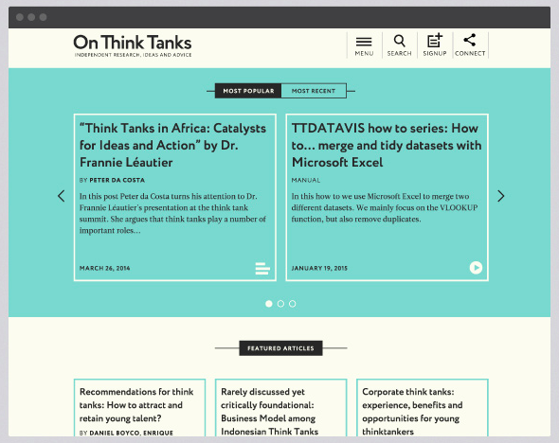

Slide 3
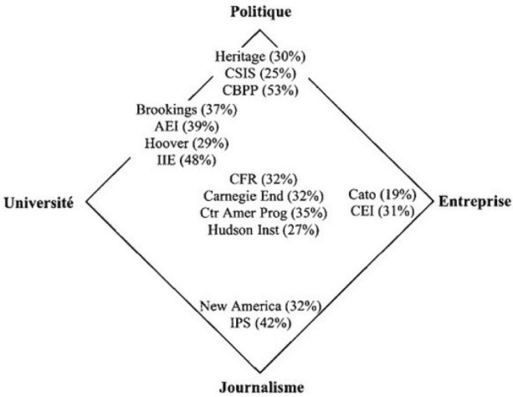
The issue with think tanks
Difficult definition: different boundaries in different countries
Source: Tomas Medvetz

Slide 4
Think tanks are in the eye of the beholder
Label popular in the West but not a western invention –certainly not the function of advice
The literature describes them at the service of, either:
  Elites (political, intellectual, economic),
  The State,
  The Market
…depending on the political, social and economic context

Slide 5
Think tanks are not just a source of policy ideas
They can also:
  Educate the elites (and why not, entertain)
  Train future generations of policymakers
  Hold to account
  Break intellectual stagnation
  Give continuity to institutions
  Legitimate power
  Etc.

Slide 6
The question of democracy
Is it a driver of think tank formation?
  (It can help but it is not necessary and not enough)
Is it a consequence of think tank activity?
  (They can help but can also legitimate de facto power and are certainly not enough)
Can think tanks exist without democracy?
  (Sure in fact they can emerge because of its absence)

Slide 7
Back to the question of think tanks
Additional question:
Can they undermine democracy?

Slide 8
4 Questions and 4 Cases
Are they a cause?
Could they undermine it?
Are they a consequence?
Can they exist in its absence?
The cases of the US, Germany and Britain
The case of Aid
The case of Chile
The case of China

Slide 9
The cases of the US, Germany and Britain
Three democracies
The US has lots of think tanks -most are very small a few very large
The UK has fewer think tanks than the US -most are very small
Germany has only a few think tanks –most are not even think tanks

Slide 10
US, Germany and Britain
What is behind the differences?
  US has weak Political Parties and many levels of government
  UK has strong Political Parties and a highly antagonistic political culture
  Germany has strong Parties but a political culture that favours dialogue
  The “roles” of the state, the market and civil society are different in these three democracies

Slide 11
Conclusion 1
Not all democracies are the same

Slide 12
The case of Aid
Aid funders like impact: they fund think tanks who promise impact
  Impact is easier if done in private–through networks of power and influence
  Impact is harder if there are no “alternative opinions”
  Impact is easier if we by-pass debate
  Impact is harder if the general public is able to join the debate
But this is not very democratic

Slide 13
Woodrow Wilson warned:
Democracy is under threat from technocracy –where unelected experts decide how resources are allocated
The Economist agreed during the Greek Debt Crisis –who elected the technocrats of the EU and the IMF?
New philanthropists agree, too: Rohini Nilekani funds think tanks in India who disagree with her but offer to strengthen the policy debate

Slide 14
Conclusion 2
Think tanks can undermine democracy – it will depend on the principles of their funders and of their leaders and staff.
Worth asking another question: Are there for influence or for better policy? These are not the same

Slide 15
The case of Chile
1950 to 1973: Very few think tanks. Most research undertaken in universities and mostly conceptual. Significant investment in higher education
11/9 1973: Pinochet dictatorship starts
1973-1980: The rise of think tanks. Researchers “flee” universities, find safety in think tanks, focus on “evidence based policy”
1980-1989: Think tanks as conveners of Political leaders, opposition activists, intellectuals, etc.
1990 onwards: Democracy! Think Tank Cabinet!

Slide 16
The story continues
1990 onwards: New think tanks appear, on the right, to protect the policies of the previous regime.
2000 onwards: New cross-party think tanks or think tank networks emerge to deal with policy issues

Slide 17
Conclusion 3
Think tanks can emerge in the most anti-democratic of environments (even in opposition)

Slide 18
Think tank contribution
According to Jeffrey Puryear,
“the most significant contribution was psychological, not intellectual”
Even though almost the entire Aylwin Cabinet came from think tanks

Slide 19
Conclusion 4
Think tanks can drive and contribute to democratic transitions –both with ideas and with the practice of democratic principles

Slide 20
The case of China
After Polish and Hungarian uprisings in the 1950s Mao decided he could not trust his own advisers and set up the first foreign policy think tanks
Think tank formation then driven by Chinese State’s and Party’s need for information
Windows: Chinese think tanks characterised as windows into the US and Europe (and Africa and Latin America and the Middle East)

Slide 21
Intra-Party competition
Like Mao, party members wanted independent advice and sponsor many small think tanks
Sea Turtles: Many new think tanks founded by returnees from the US and Europe (from think tanks there). Many are funded by returnees also.
Now China wants more think tanks to tackle its ever growing list of challenges: new private and state think tanks, new conferences and rankings, new international partnerships, etc.

Slide 22
Conclusion 5
Single Party States can be sponsors of think tanks

Slide 23
So a happy ending… but happy story, too?
Cultural revolution wasn’t fun
After Tiananmen many think tanks closed and the political space for think tanks shrunk for many years
The new think tank looks more like the Chilean evidence based think tank: talk about the policies, not about the politics. But there are more and more.

Slide 24
Conclusion 6
Single Party States can also close them down at any time

Slide 25
Conclusions
Not all democracies are the same
Think tanks can undermine democracy – it will depend on the principles of their funders and the of their leaders and staff.
Think tanks can emerge in the most anti-democratic of environments (even in opposition)
Think tanks can drive and contribute to democratic transitions –both with ideas and with the practice of democratic principles
Single Party States can be sponsors of think tanks
Single Party States can also close them down at any time

Slide 26
The good think tank (in democratic transitions)
Undertake quality research and analysis
Where democratic institutions are weak (e.g. the media, parties, parliament, the civil service, academia) do not take advantage of this and instead seek to strengthen them –play the long game
Seek to inform policy openly, not privately
Bring the public along with you, do not leave it behind
Be transparent (about your funding, your methods, you values)
Cherish a good debate –especially those where you will learn a thing or two

Slide 27
Gracias
@onthinktanks
facebook.com/onthinktanks
onthinktanks.org

